Slide 1
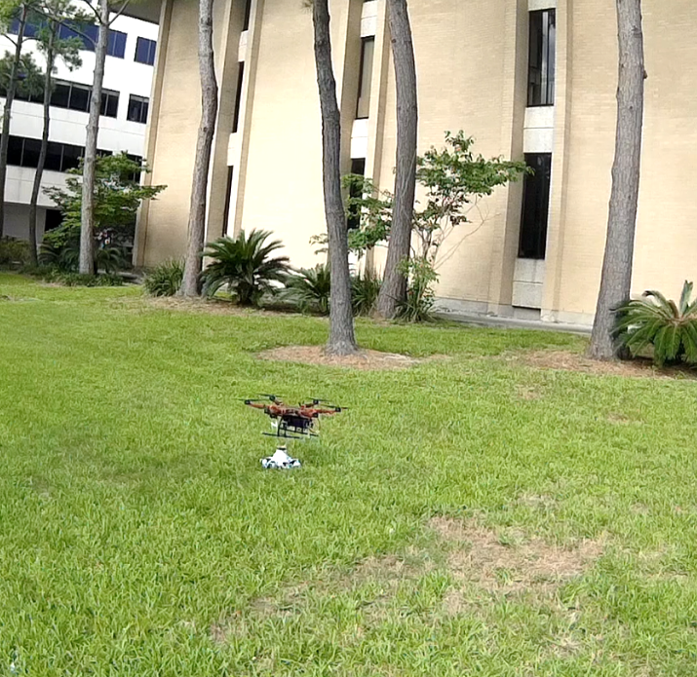
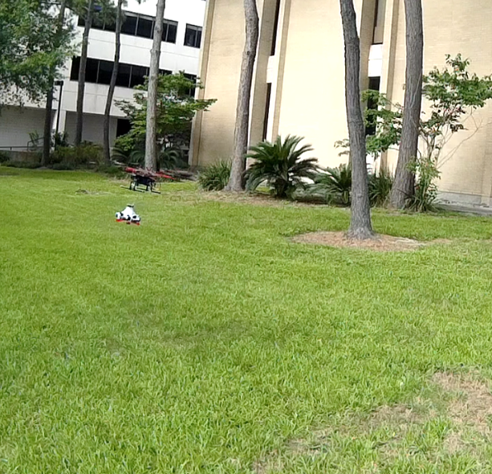
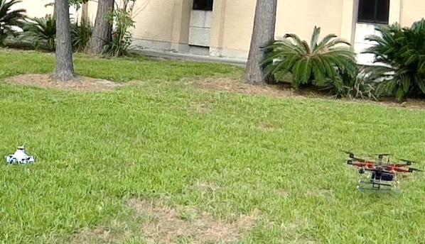
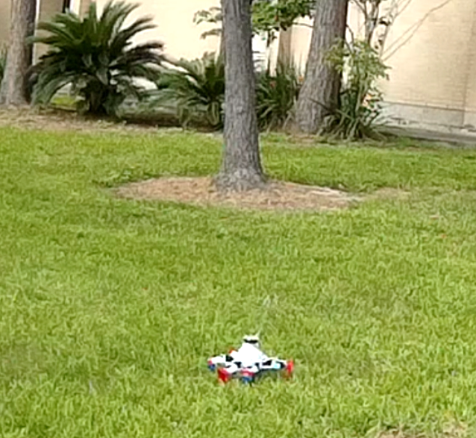
a.
b.
c.
d.
T = 50s
Wriggle
Geophones
T = 20s
Retrieval
T = 35s
Deploying
T = 40s
Deployed

